Slide 1
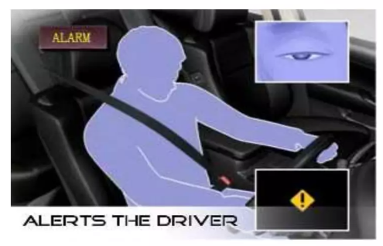

Drowsy Driver Detection System
by Tejal Mane

Slide 2
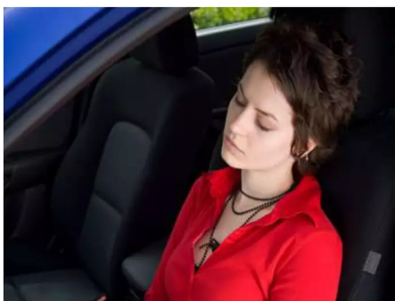
Abstract
Key highlights:
Problem: Drowsiness increases accident risks.
Solution: System detects drowsiness and alerts the driver.
Features: Alarm notification and nearby rest area suggestions.

Slide 3
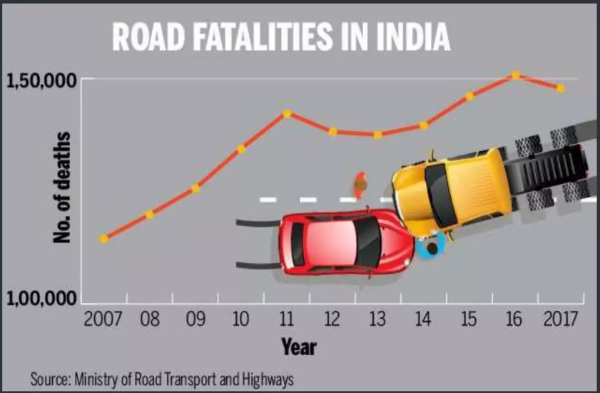
Introduction
A method for detecting drowsiness in drivers is developed by using a camera that point directly towards the drivers face and capture for the real time video. Once the video is captured, monitoring the face region and eyes in order to detect drowsy. The system able to monitoring eyes and determines whether the eyes are in an open position or closed state. In such a case when drowsiness is detected, a warning signal is issued to alert the driver.
Statistics:
30% of accidents caused by drowsiness.
Drowsiness accidents more severe than others.
Techniques Overview:
Image Processing
CNN-Based Methods

Slide 4
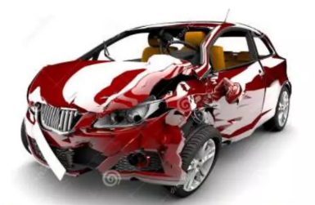
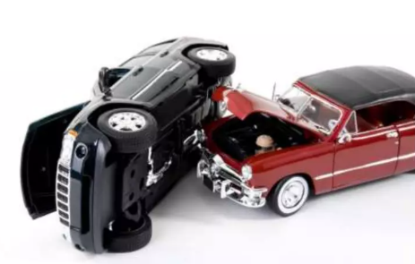
Objective and Approach
Objective:
Detect driver drowsiness.
Prevent accidents through real-time alerts.
Methodology:
Eye state classification using CNN.
Real-time monitoring with webcams.

Slide 5



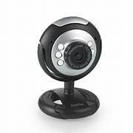
System Requirements
Hardware:
PC, Webcam.
Software:
Python, OpenCV, TensorFlow-Keras, Pygame.

Slide 6
Dataset
Description:
Custom dataset: 7,000 images.
Labels: "Open" and "Closed”.
Cleaning:
Removed unnecessary images

Slide 7
Model Architecture
Layers:
Convolutional Layers: 32 and 64 nodes.
Fully Connected Layers: 128 nodes, 2-node output layer.
Activation Functions:
ReLU for hidden layers.
Softmax for output.

Slide 8
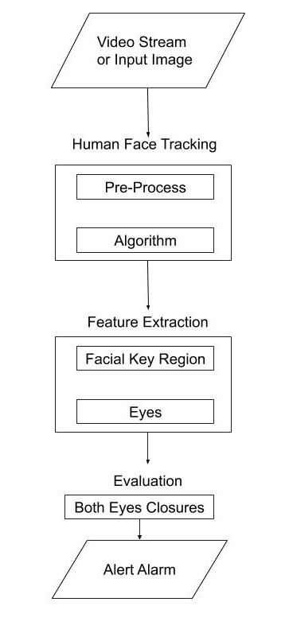
System Design
Algorithm :
Capture image.
Detect face and eyes.
Predict eye state using CNN.
Alert if drowsiness detected.

Slide 9
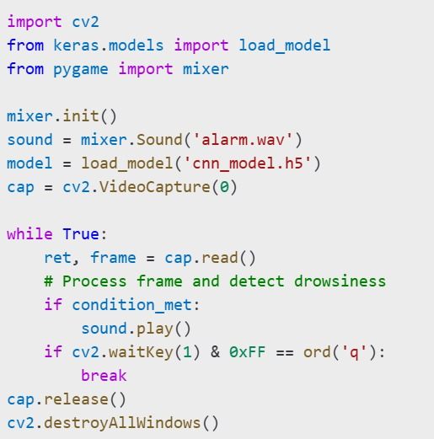
Implementation
Steps:
1. Real-time image capture.
2. Grayscale conversion and resizing.
3. Eye state prediction with CNN.
4. Alert if eyes closed for prolonged period.

Slide 10
Results
Performance:
High accuracy in diverse conditions.
Effective even with spectacles and low light.
Impact:
Reduced accident risk.

Slide 11
Conclusion
The Driver Drowsiness Detection System with OpenCV is a project that uses computer vision and machine learning algorithms to detect drowsiness in drivers. By analyzing the driver's facial features, such as the eyes and mouth, the system can determine if the driver is showing signs of drowsiness and can alert them to take action to avoid accidents. This project demonstrates the potential of computer vision and machine learning to develop innovative solutions for real-world problems, such as reducing accidents caused by drowsy driving.

Slide 12
Thank You!

